Slide 1
Defect Inspection
1
2
3
4
MILESTONE
MILESTONE
MILESTONE
MILESTONE
Choosing Data
Data Preparation
Choosing Model
Evaluation and Deployment

Slide 2
Agenda
Dataset
Data preparation
Preprocessing
Experiments
Model
Evaluation
Deployment

Slide 3
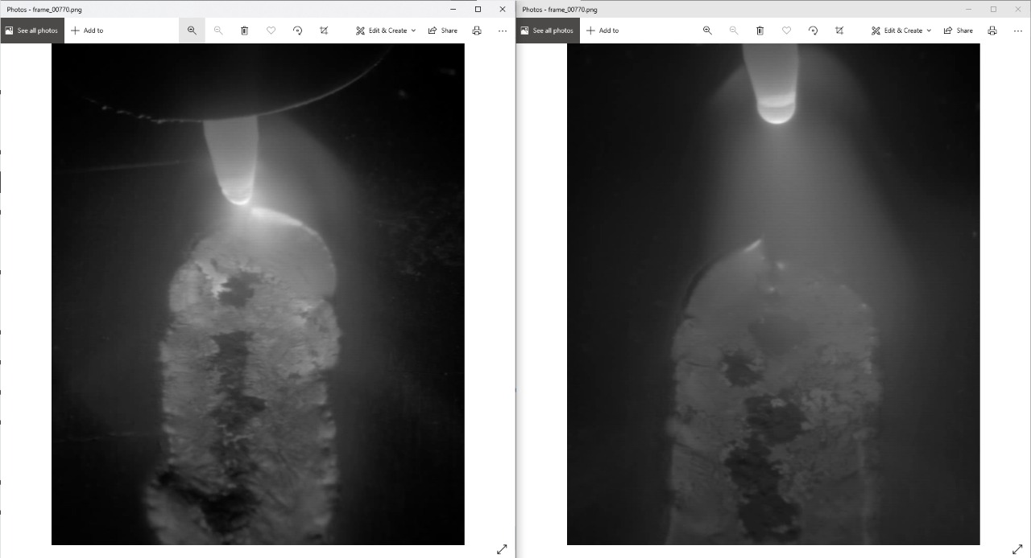
Data
Chosen Dataset:
TIG Aluminium 5083 → TIG welding footages recorded with HDR camera
Rejected Datasets:
BSData - dataset for Instance Segmentation and industrial Wear Forecasting
MVTec Anomaly Detection Dataset (MVTec AD) 2019
Severstal Steel Defect Detection 2019
Textures Classification Dataset 2019
Kolektor Surface-Defect Dataset 2019
A concrete crack image dataset for machine learning applications 2018
Defective Solar Cells Dataset 2018

Slide 4
Info about the Aluminum dataset
Tungsten inert gas welding, is an arc welding process that uses a non-consumable tungsten electrode to produce the weld. In TIG welding, there generally occurs these following cases:
Good weld
Burn through
Contamination
Lack of fusion
Misalignment
Lack of penetration

Slide 5
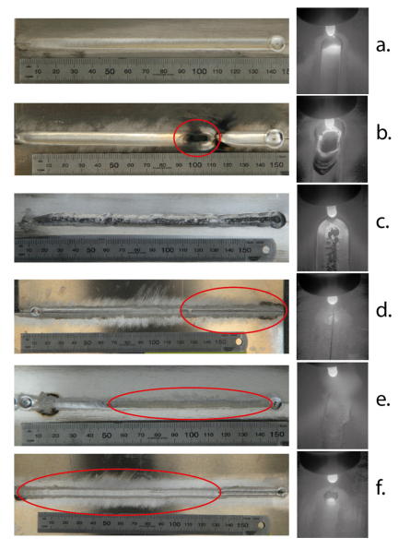

Slide 6
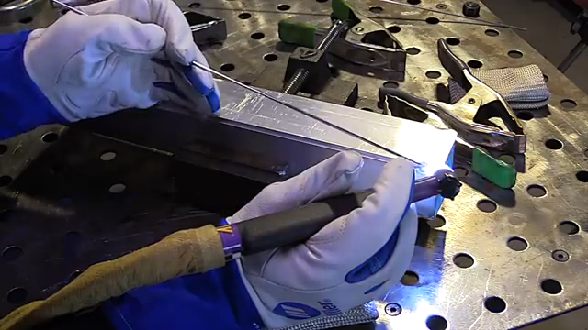

Slide 7
Data preparation
Combine test and train folders
Divide data in to train and test with same distribution ratio
Divide data into two classes Good weld and defect

Slide 8
Pre-Processing
Resize
Convert Image to tensor
Normalization

Slide 9
Experiments:
There are some experiments done to choose the best model for defect detection. These experiments can be separated into three categories:
first category : using 6 classes.
second category: using 4 classes.
third category: using 2 classes.

Slide 10
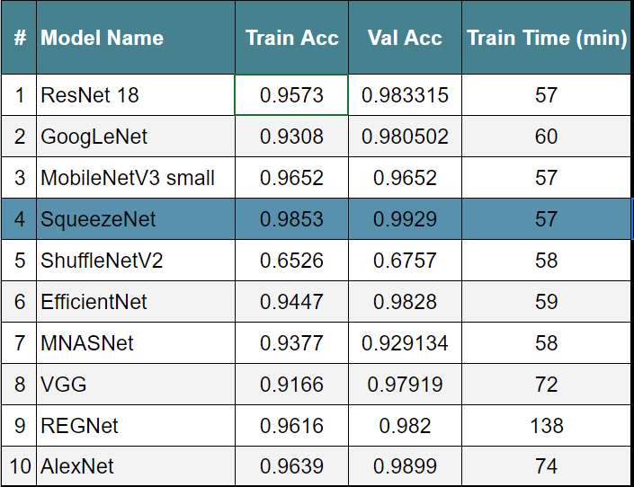
Results from first category

Slide 11
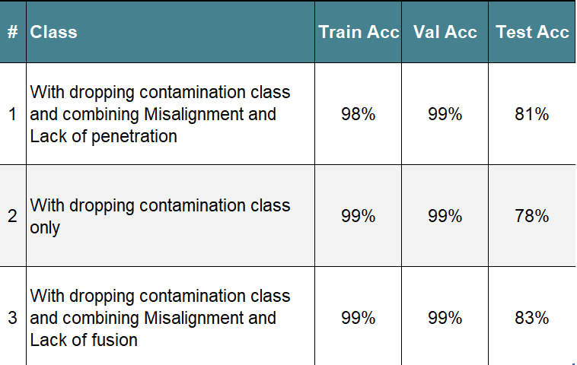
Results from second category

Slide 12
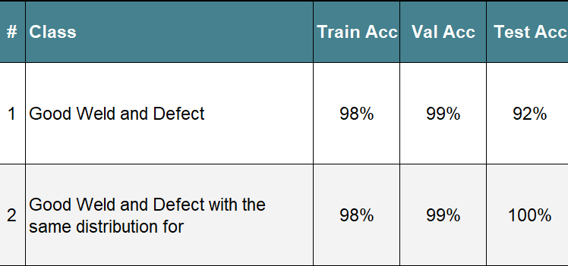
Results from Third category

Slide 13
Model

Slide 14
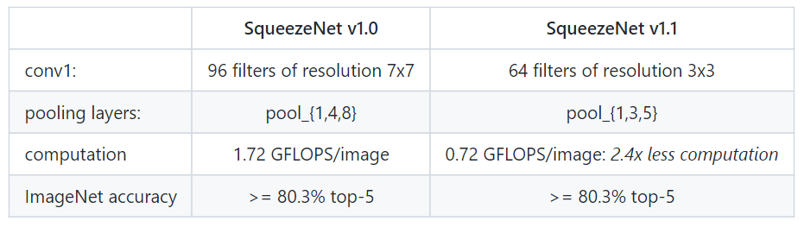
SqueezeNet v1.0 vs SqueezeNet v1.1

Slide 15
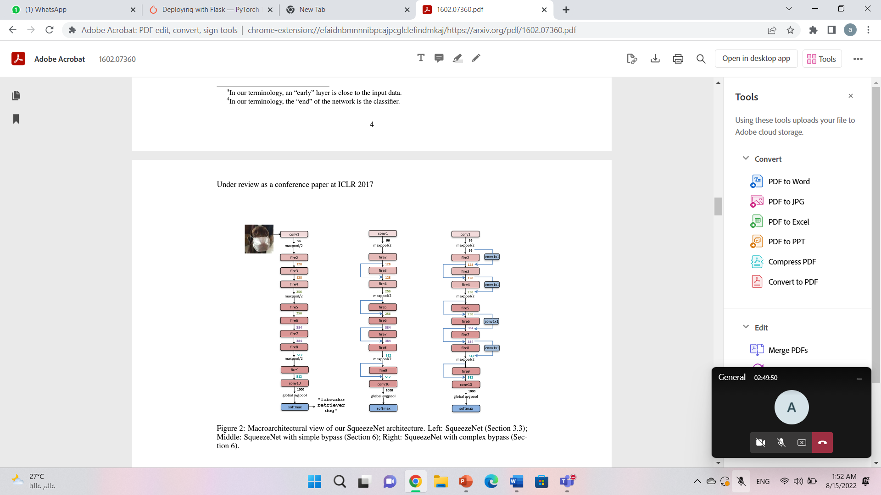

Slide 16
Evaluation

Slide 17
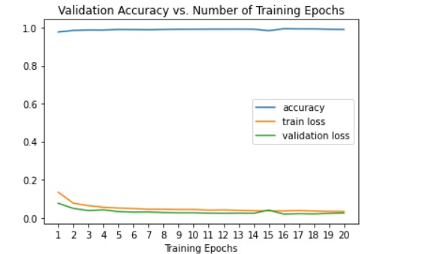
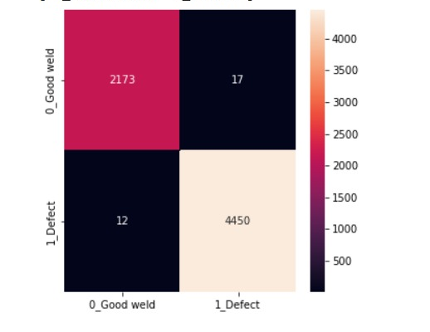
SqueezeNet for 2 classes:

Slide 18
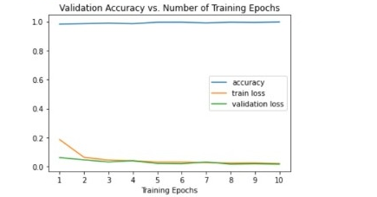
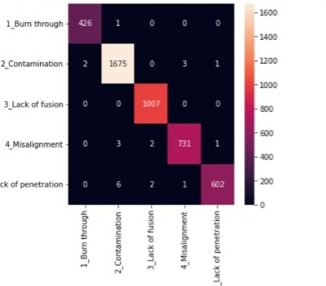
SqueezeNet for classifying the defection

Slide 19
Deployment

Slide 20
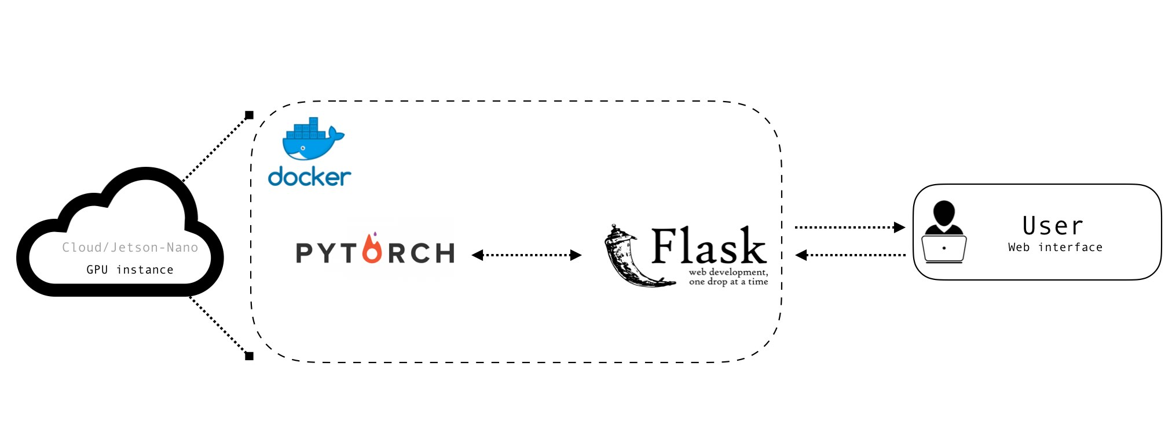
Deployment PyTorch model using flask

Slide 21
pipeline
Dependencies
Declare flask
wrap your trained PyTorch model in a Flask container to expose it via a web API
Prepare the image
Inference
Integrating the model in our API Server methods=['POST']

Slide 22
Deployment Preprocessing
The web request gave us an image file, but our model expects a PyTorch tensor of shape (N, 3, 224, 224) where N is the number of items in the input batch.
The first thing we do is compose a set of TorchVision transforms that resize the image, convert it to a tensor, then normalize the values in the tensor.

Slide 23


Slide 24
Team
Aya Adel Soliman
Maria George Makram
Azza Ali Omar
Abdullah Essam Shehata

